Slide 1
ASP.NET Web API
Advanced Concepts
Rahul Srivastava

Slide 2
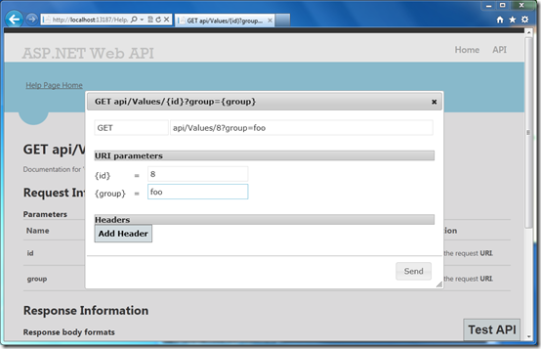
Help Page
ASP.NET and Web Tools 2012.2 Update integrates help pages into the Web API project template.
Web API generated dynamically, using the IApiExplorer interface.
Adding a simple Test Client to ASP.NET Web API Help Page

Slide 3
Format & Model Binding

Slide 4
Format & Model Binding
Serialization
Validation
Request
HTTP/1.1 200 OK
Content-Length: 95267
Content-Type: text/html | application/json
Accept: text/html, application/xhtml+xml, application/xml
Controller / Action
Deserialization
Response

Slide 5
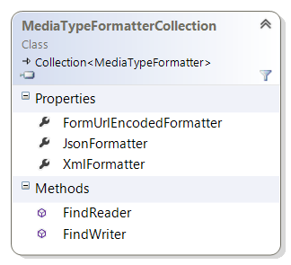
Media Formatters (Serialization)
A media-type formatter is an object that can:
Read CLR objects from an HTTP message body.
Write CLR objects into an HTTP message body.
GlobalConfiguration.Configuration.Formatters

Slide 6
JSON Media-Type Formatter
Json.NET or DataContractJsonSerializer?
var json = GlobalConfiguration.Configuration.Formatters.JsonFormatter; json.UseDataContractJsonSerializer = true;

Slide 7
JSON Media-Type Formatter
What Gets Serialized?
"opt-out" approach
"opt-in" approach
public class Product
{
public string Name { get; set; }
public decimal Price { get; set; }
[JsonIgnore]
public int ProductCode { get; set; }
}
[DataContract] public class Product
{
[DataMember] public string Name { get; set; }
[DataMember] public decimal Price { get; set; }
// omitted by default
public int ProductCode { get; set; }
}

Slide 8
JSON Media-Type Formatter
Anonymous and Weakly-Typed Objects
public object Get()
{
return new {
Name = "Alice",
Age = 23,
Pets = new List<string> { "Fido", "Polly", "Spot" } };
}
public void Post(JObject person)
{
string name = person["Name"].ToString();
int age = person["Age"].ToObject<int>();
}

Slide 9
XML Media-Type Formatter
DataContractSerializer or XmlSerializer?
var xml = GlobalConfiguration.Configuration.Formatters.XmlFormatter; xml.UseXmlSerializer = true;
The XmlSerializer class supports a narrower set of types than DataContractSerializer, but gives more control over the resulting XML. Consider using XmlSerializer if you need to match an existing XML schema.

Slide 10
Custom Media Formatter s
Derives from BufferedMediaTypeFormater.
In the constructor, add the media types that the formatter supports.
To indicate which types the formatter can serialize, Override the methods:
CanWriteType
CanReadType
WriteToStream
Use the Formatters property on the HttpConfiguration object to add a custom media type formatter.

Slide 11
Content Negotiation
The primary mechanism for content negotiation in HTTP are these request headers:
Accept
Accept-Charset
Accept-Encoding
Accept-Language
“the process of selecting the best representation for a given response when there are multiple representations available.”

Slide 12
Content Negotiation Sample
public HttpResponseMessage GetProduct(int id)
{
var product = new Product() { Id = id, Name = "Gizmo", Price = 1.99M };
IContentNegotiator negotiator = this.Configuration .Services.GetContentNegotiator();
ContentNegotiationResult result = negotiator.Negotiate( typeof(Product),
this.Request, this.Configuration.Formatters);
if (result == null) {
var response = new HttpResponseMessage(HttpStatusCode.NotAcceptable);
throw new HttpResponseException(response));
}
return new HttpResponseMessage()
{
Content = new ObjectContent<Product>(
product, // What we are serializing
result.Formatter, // The media formatter
result.MediaType.MediaType // The MIME type
)
};
}

Slide 13
Validations

Slide 14
Model Data Annotations
Specify validation for individual fields in the data model.
System.ComponentModel.DataAnnotations
Provide both client and server validation checks with no additional coding required by you.
public class ProductMD { [StringLength(50), Required] public string Name { get; set; } [Range(0, 9999)] public int Weight { get; set; } }

Slide 15
Validation Attributes
Metadata Validation Attributes:
[Required]
[Exclude]
[DataType]
[Range]
[StringLength(60)]
[RegularExpression]
[AllowHtml]
[Compare]
[MetadataTypeAttribute( typeof( Employee.EmployeeMetadata ) )]
public partial class Employee
}
internal sealed class EmployeeMetadata
}
[StringLength(60)]
[RoundtripOriginal]
public string AddressLine { get; set; }
}
}
Notes:
[ExternalReference] [Association("Sales_Customer", "CustomerID", "CustomerID")]

Slide 16
Web API Validation
public class ProductsController : ApiController
{
public HttpResponseMessage Post(Product product)
{
if ( ModelState.IsValid ) {
// Do something with the product (not shown).
return new HttpResponseMessage(HttpStatusCode.OK);
}
else {
return new HttpResponseMessage(HttpStatusCode.BadRequest);
}
}
}

Slide 17
Custom Validation
public class ModelValidationFilterAttribute : ActionFilterAttribute
{
public override void OnActionExecuting(HttpActionContext actionContext)
{
if (actionContext.ModelState.IsValid == false)
{
// Return the validation errors in the response body.
var errors = new Dictionary<string, IEnumerable<string>>();
foreach ( var keyValue in actionContext.ModelState )
{
errors[keyValue.Key] =
keyValue.Value.Errors.Select(e => e.ErrorMessage);
}
actionContext.Response =
actionContext
.Request
.CreateResponse(HttpStatusCode.BadRequest, errors);
}
}
}

Slide 18
Custom Validation
public class ModelValidationFilterAttribute : ActionFilterAttribute
{
public override void OnActionExecuting(HttpActionContext actionContext)
{
if (actionContext.ModelState.IsValid == false)
{
// Return the validation errors in the response body.
var errors = new Dictionary<string, IEnumerable<string>>();
foreach ( var keyValue in actionContext.ModelState )
{
errors[keyValue.Key] =
keyValue.Value.Errors.Select(e => e.ErrorMessage);
}
actionContext.Response =
actionContext
.Request
.CreateResponse(HttpStatusCode.BadRequest, errors);
}
}
}
protected void Application_Start() {
// ...
GlobalConfiguration
.Configuration
.Filters.Add(new ModelValidationFilterAttribute());
}

Slide 19
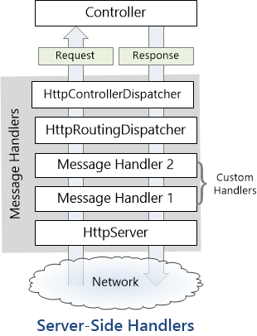
Server-Side Message Handlers
The Web API pipeline uses some built-in message handlers:
HttpServer gets the request from the host.
HttpRoutingDispatcher dispatches the request based on the route.
HttpControllerDispatcher sends the request to a Web API controller.
You can add custom handlers to the pipeline.

Slide 20
Thanks
Rahul Srivastava

